Slide 1
Data Stuctures and Algorithms
Dr. Fidaa Abed

Slide 2
AVL Tree
AVL Tree
Binary Search Tree
difference between heights of left and right
subtrees cannot be more than one
for all nodes.

Slide 3
AVL Tree
Binary Search tree
Binary Search Tree
difference between heights of left and right
subtrees cannot be more than one
for all nodes.
Not AVL Tree:
Height of left(node 8) is 2
Height of right(node 8) is 0
Difference is more that 1

Slide 4
Why AVL Tree?
Worst Case Analysis:
Insert: O(h)
Search O(h)

Slide 5
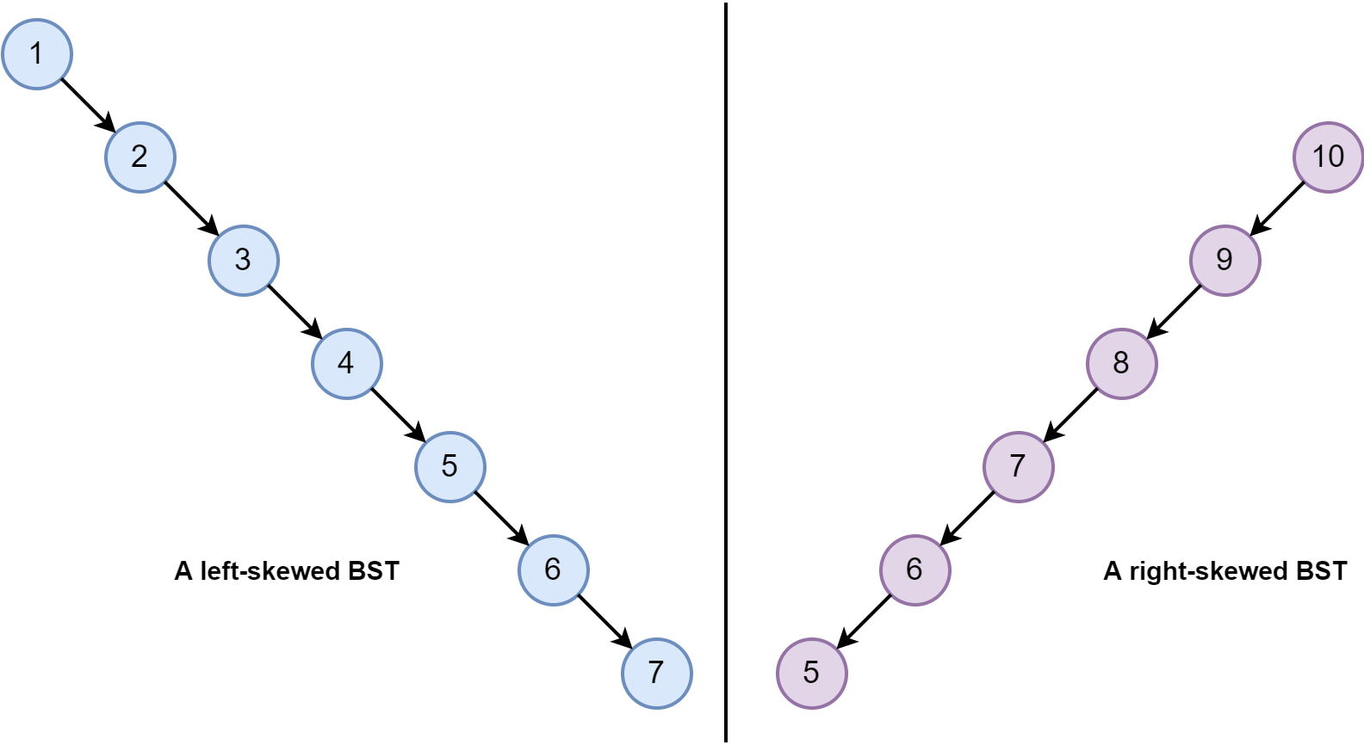
Why AVL Tree?
Worst Case Analysis:
Insert: O(h)
Search O(h)
In some situation h can be as large as n
So the efficiency is O(n)

Slide 6
Why AVL Tree?
Worst Case Analysis:
Insert: O(h)
Search O(h)
In AVL tree h is log n
So the efficiency is O(log n)

Slide 7
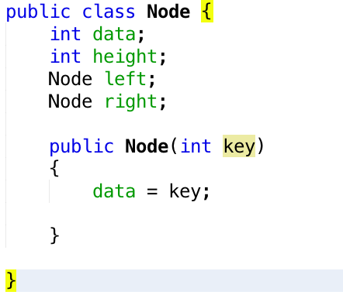
Class Node

Slide 8
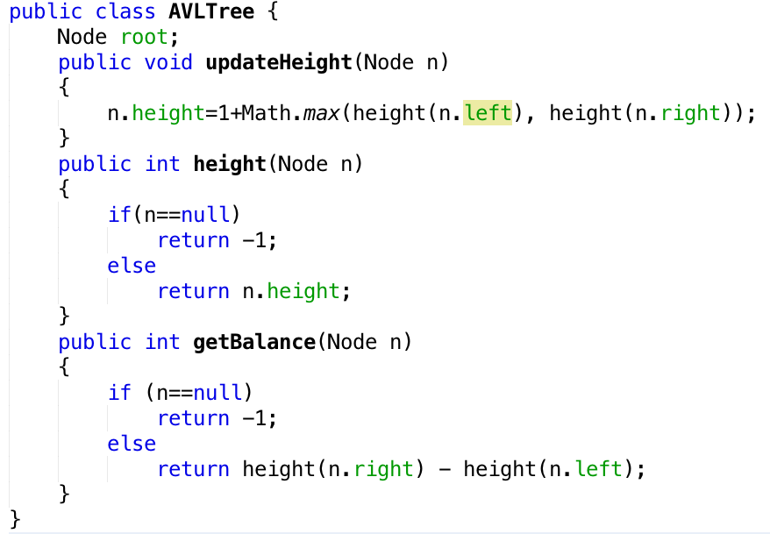
Class AVL

Slide 9
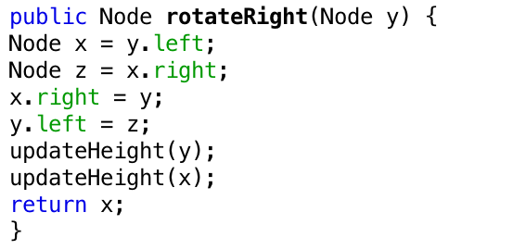
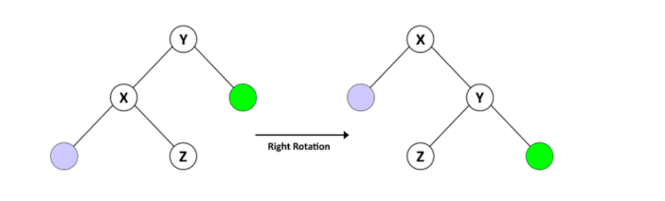
Class AVL (Right Rotation)

Slide 10
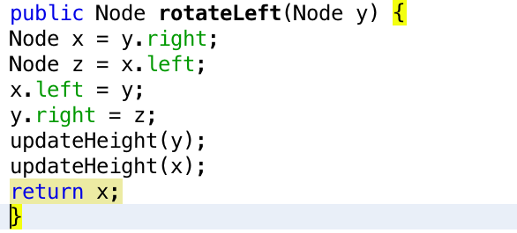
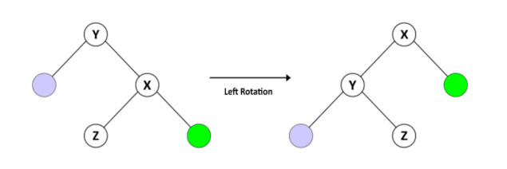
Class AVL (Left Rotation)

Slide 11
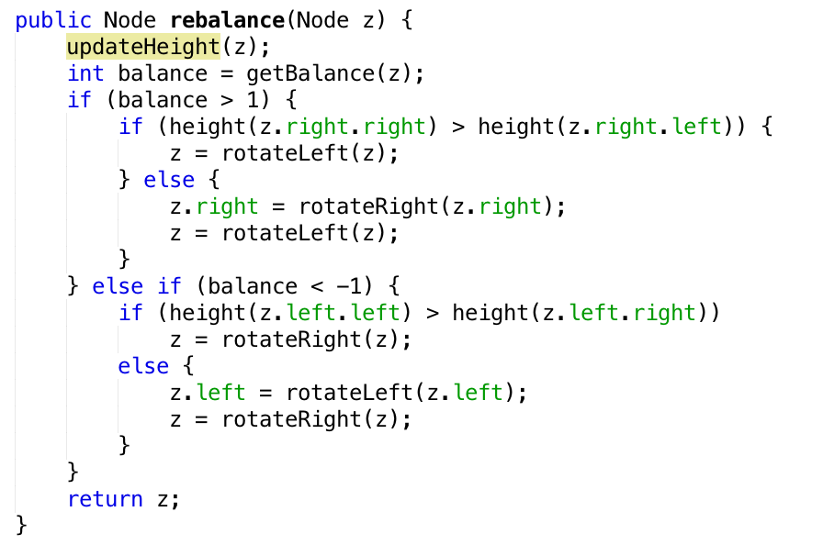
Class AVL (Rebalacing)

Slide 12

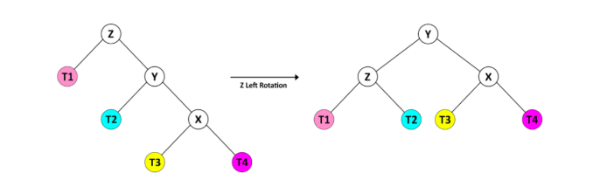
Case 1

Slide 13
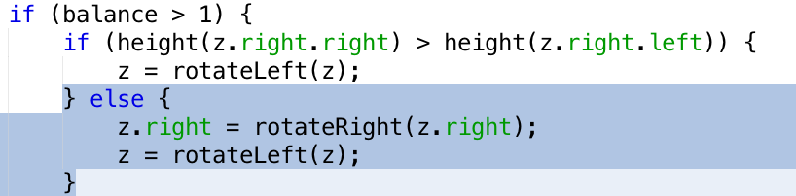
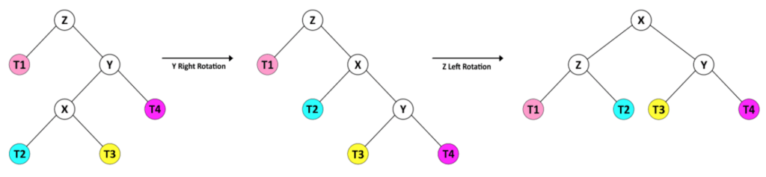
Case 2

Slide 14
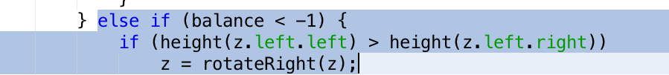
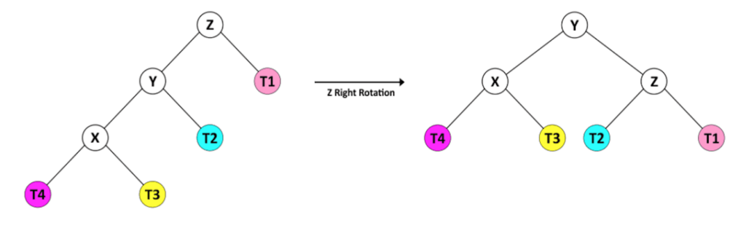
Case 3

Slide 15
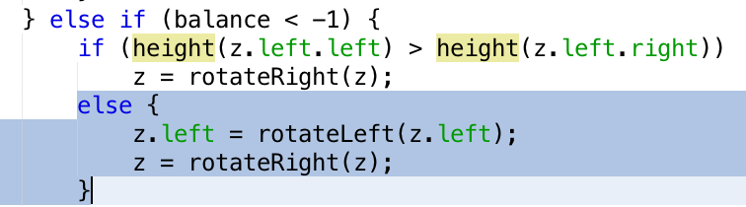
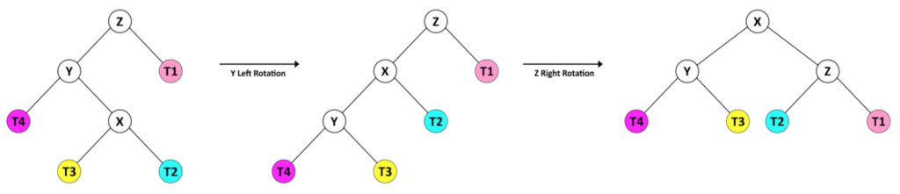
Case 4

Slide 16
Class AVL (Rebalacing)

Slide 17
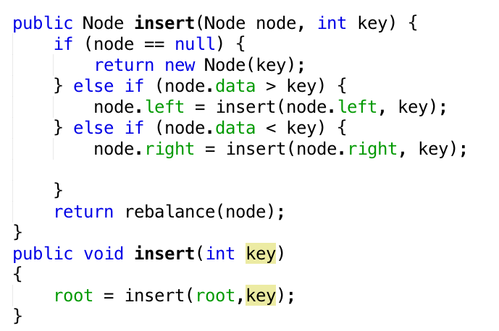
Insert

Slide 18
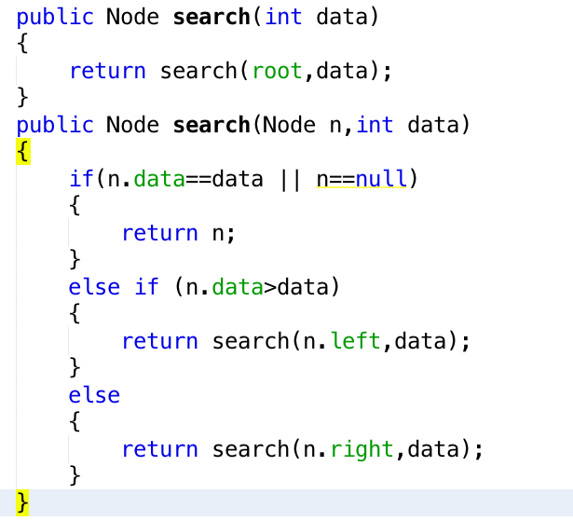
search

Slide 19
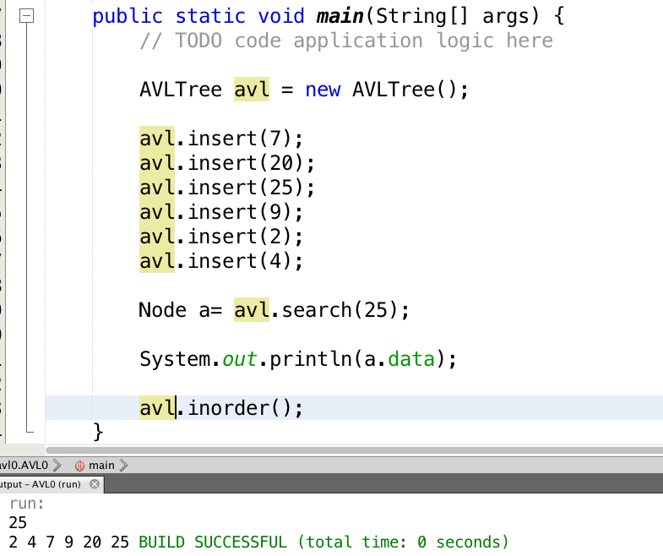
Main Class

Slide 20
Excercise
Implement AVL Tree and test it

